Slide 1

Limonese Ceole: The creole language of Costa Rica
René Zúñiga Argüello
May 11th, 2019
IELLab Reunion

Slide 2
In this presentation
  Language background
  Action plan for revitalization
  Work done at the IELLab
  Q&A

Slide 3
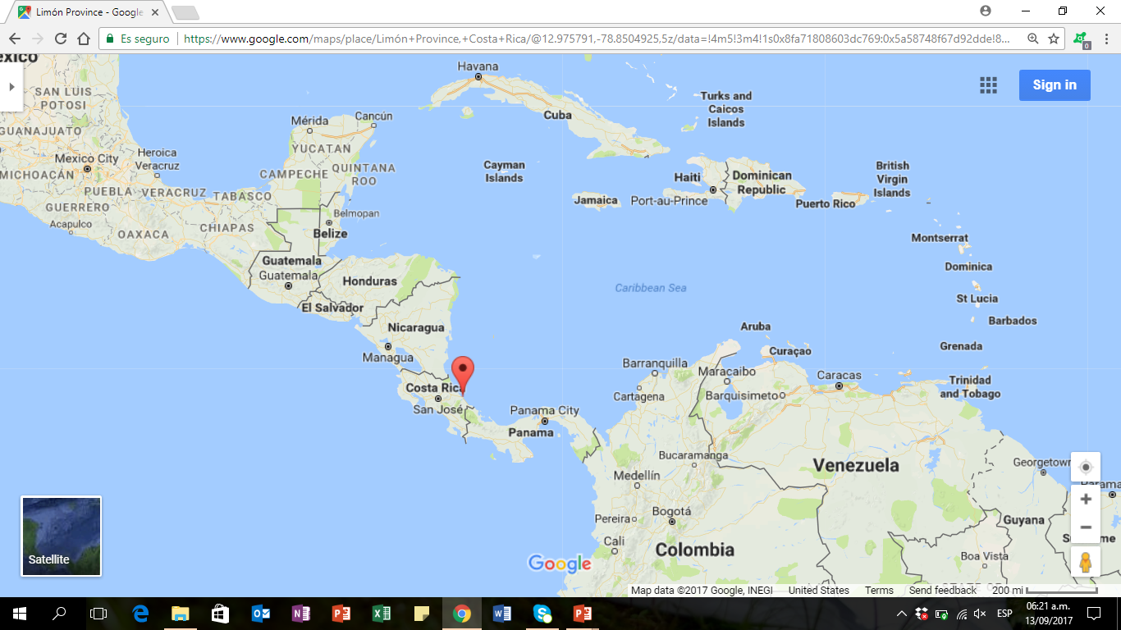
1. Language background
  Railroad (1872)
  Banana plantation
  Life in Limon at that time (bilingual)
  1949: Limon people became Costa Rican citizens

Slide 4
Current situation
  Greater stigmatization (from outside and inside)
  Loss of linguistic domains
  Fragmented linguistic identity
  Legal status

Slide 5
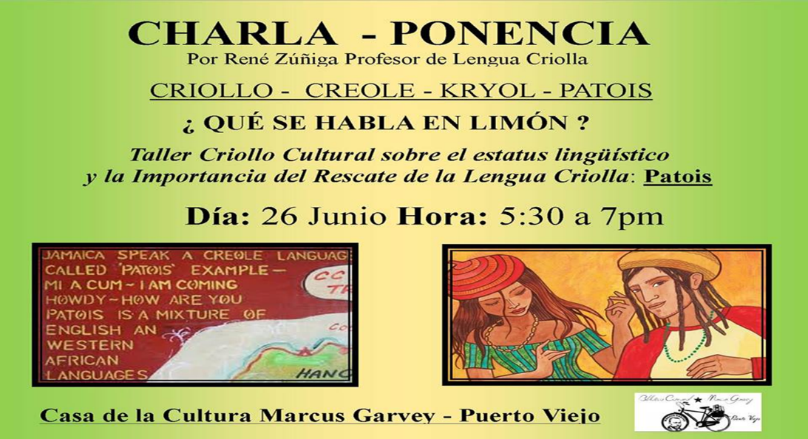
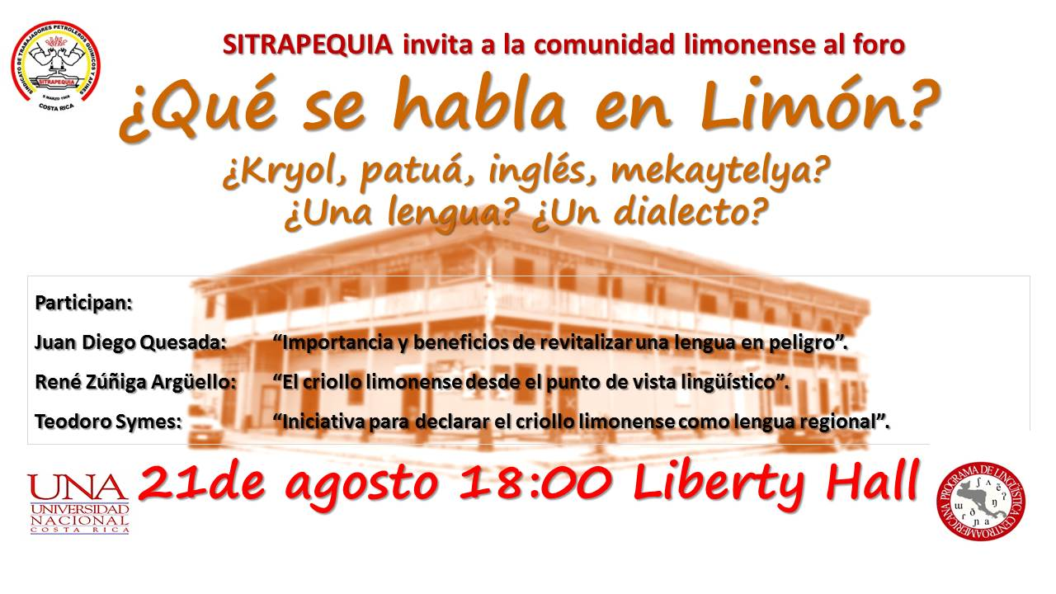
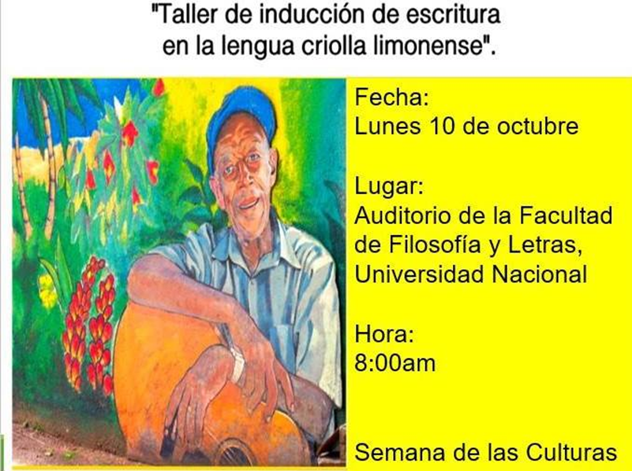
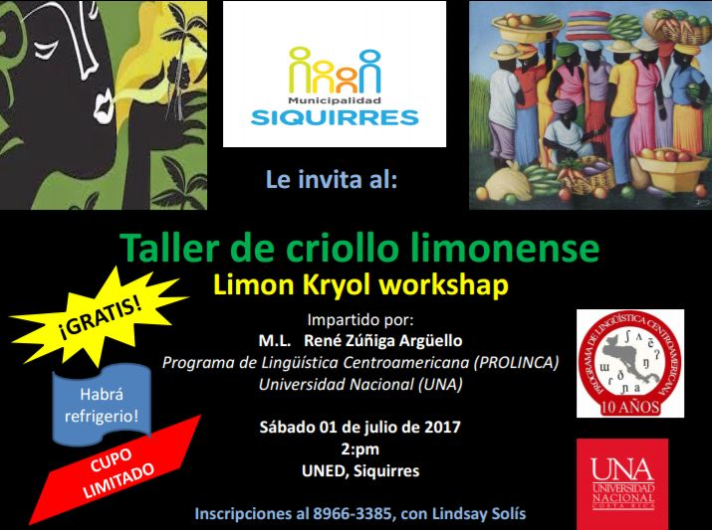
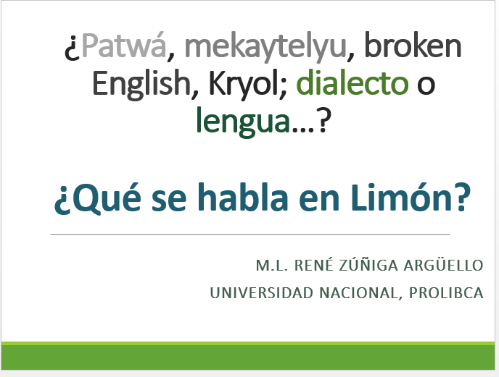
2. Action plan for revitalization
2.1 What is spoken in Limon is a language just like any other, a creole language.

Slide 6

2.2 Illustrated alphabet

Slide 7
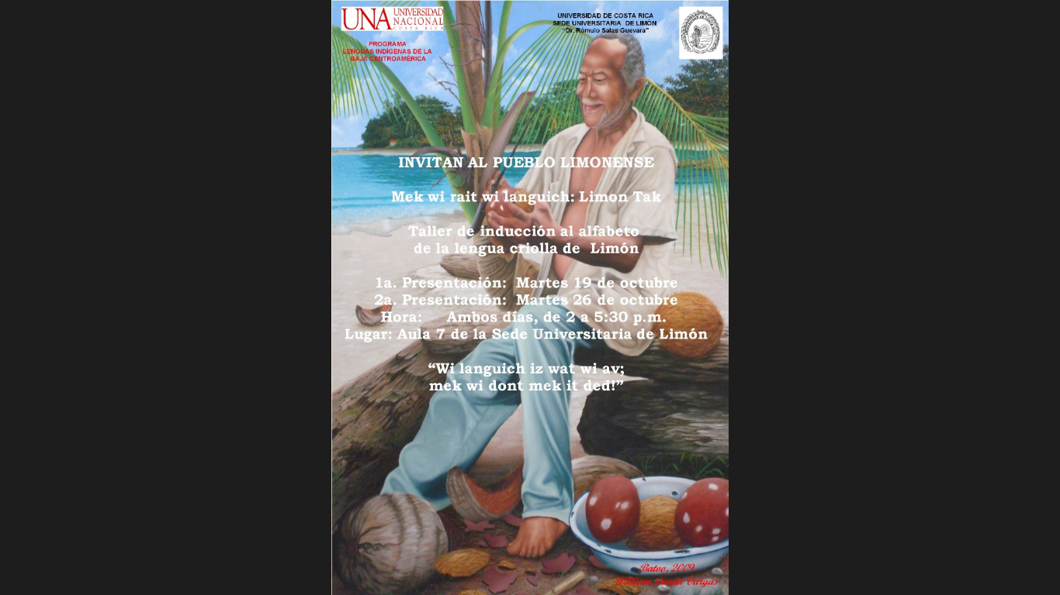


Slide 8
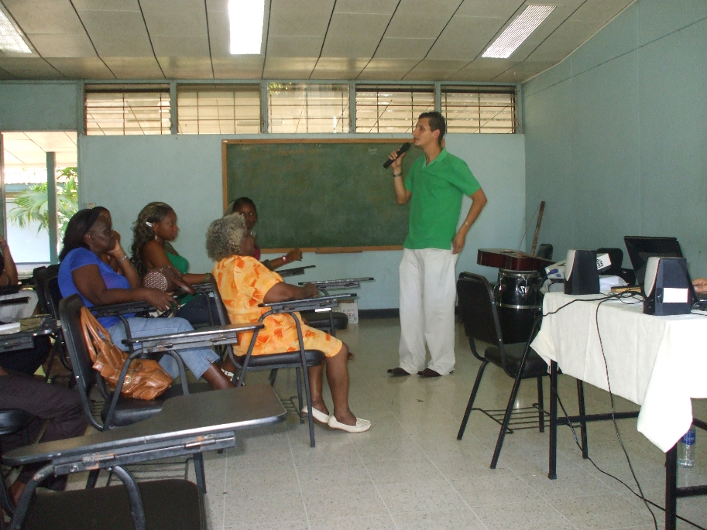
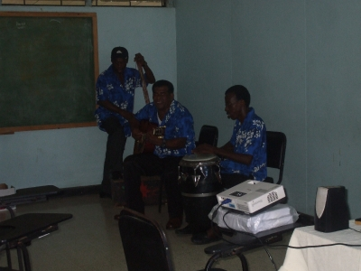
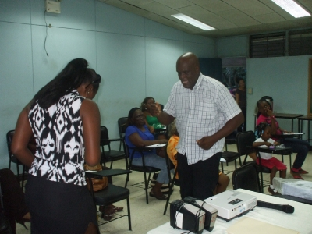
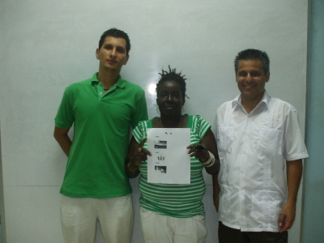

Slide 9
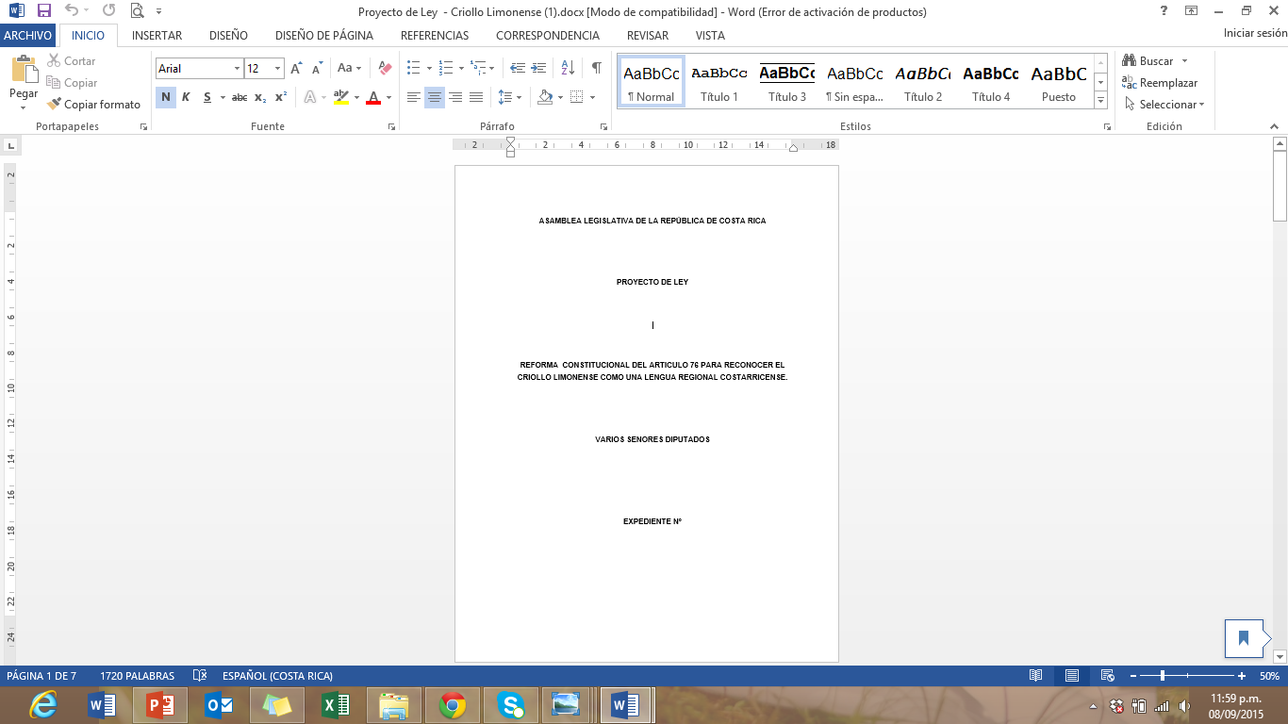
2.3 Recognition in the Political Constitution

Slide 10
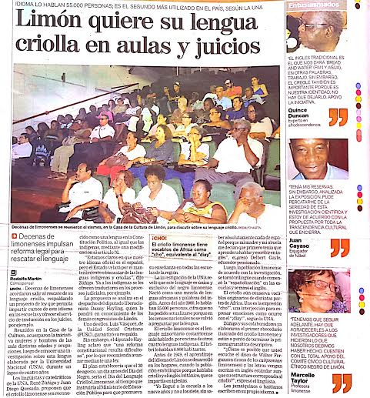
http://www.nacion.com/nacional/Limonenses-lanzan-rescatar-lengua-criolla_0_1545445490.html

Slide 11
2.4 Other actions
UNESCO Intangible
cultural heritage
Limon Kryol Day
(August 30th)
…

Slide 12
3. Work done at the IELLab
A formal syntactic analysis of motion predicates in Limonese Creole
3.1 The general claim
3.2 Path (3D planes)
3.3 Telicity

Slide 13
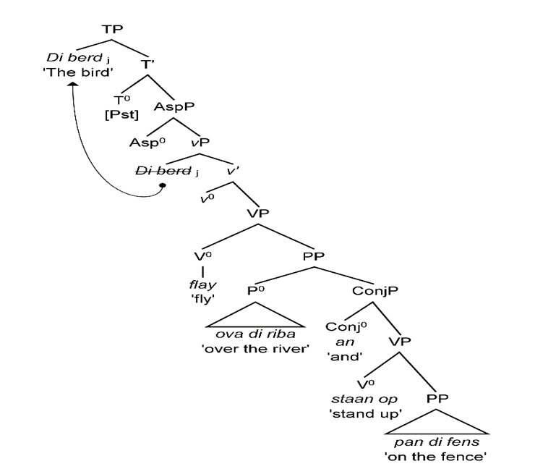
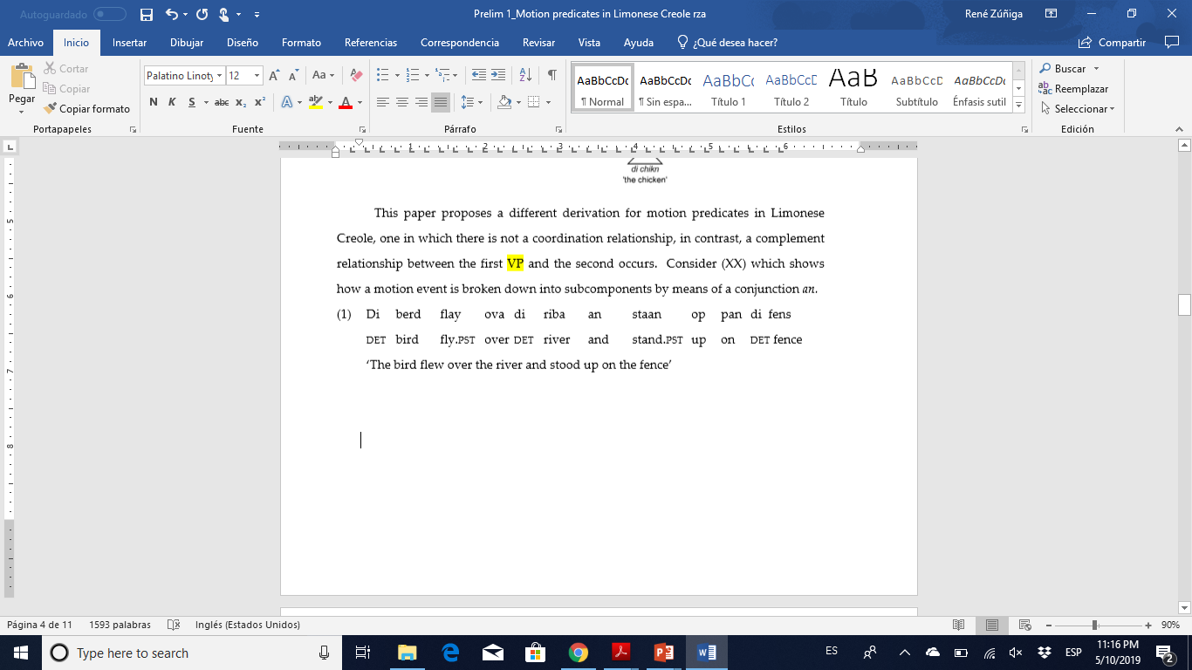
3.1 The general claim

Slide 14
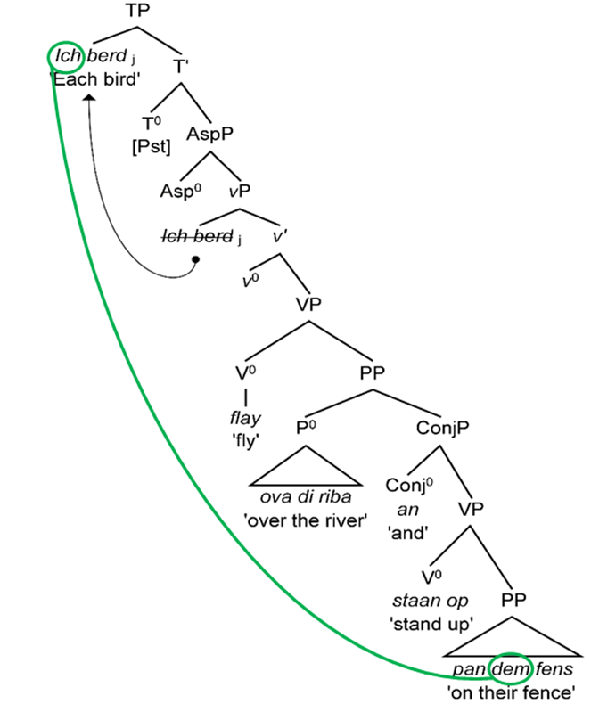
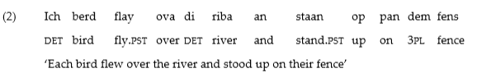
Bound variable test

Slide 15
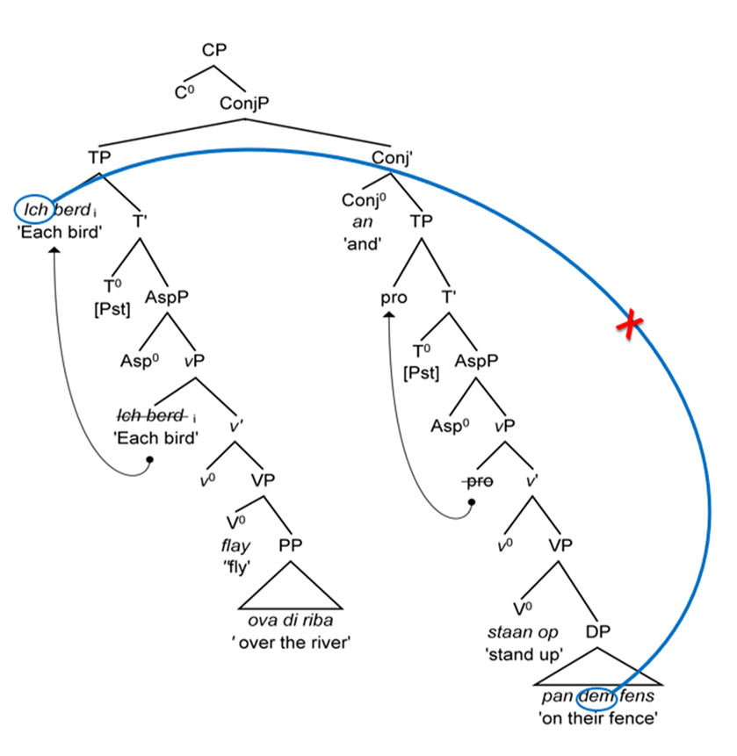
Discarding TP coordination
But, what about VP or even vP coordination?

Slide 16
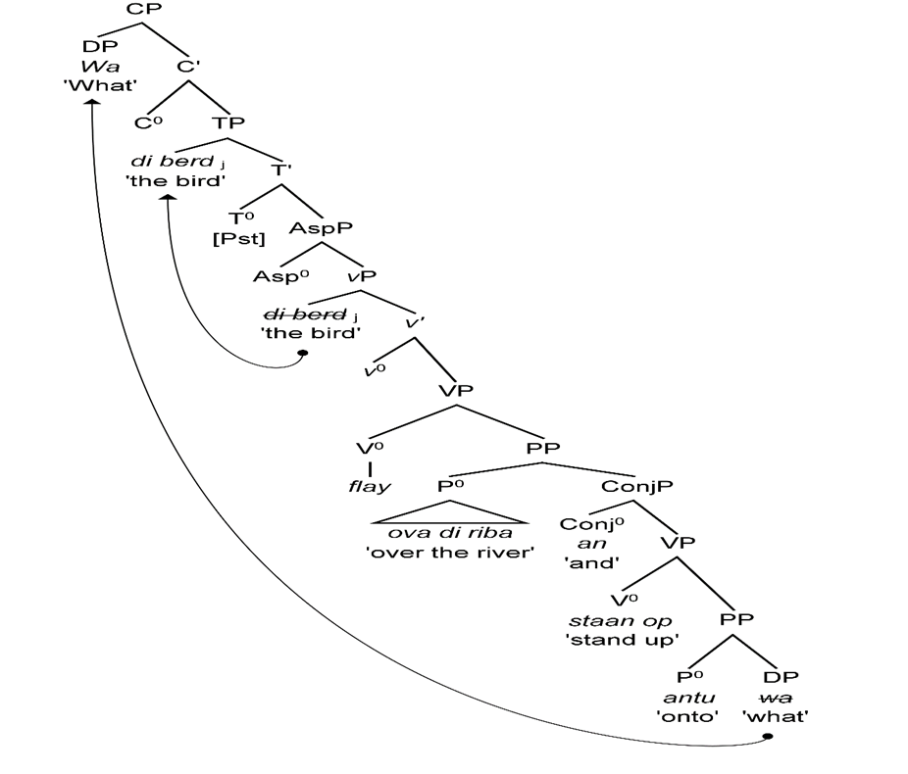
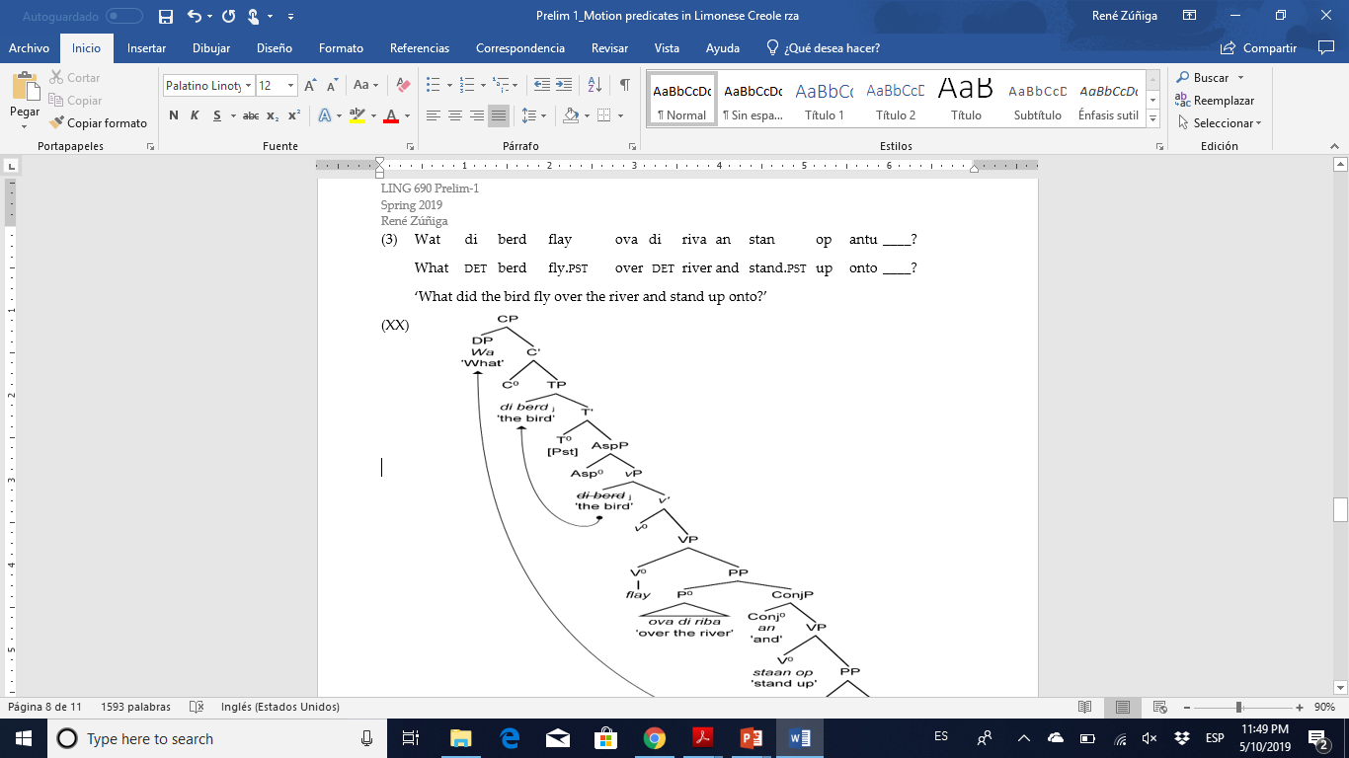
Wh-extraction test

Slide 17
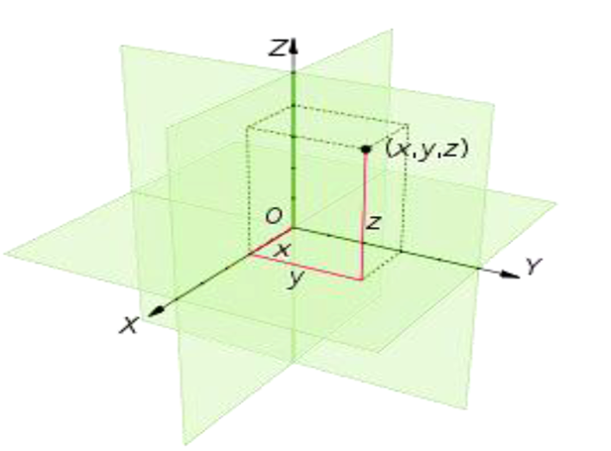
3.2 Path

Slide 18
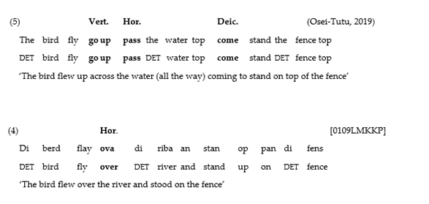
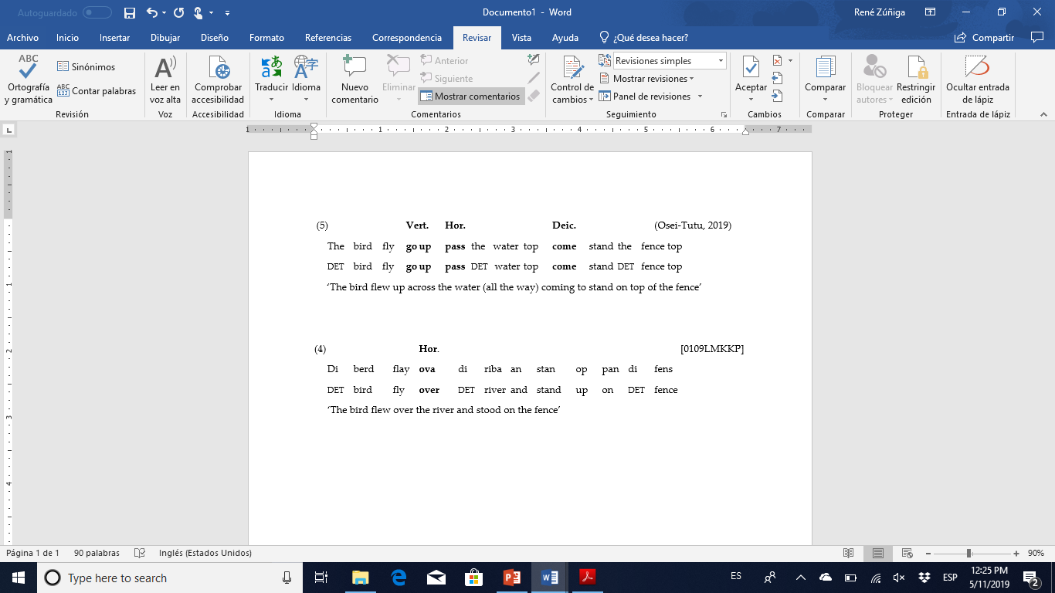
Just a single plane in Limonese Creole
Ghanian Student Pidgin

Slide 19
3.3 Telicity
 | PERF | END POINT
Telic | + | +
Atelic-underspecified | - | +
Atelic-unspecified | -/+ | -

Slide 20
Thank you!

